Slide 1
Why Functional Programming
OOP makes code understandable by encapsulating moving parts. FP makes code understandable by eliminating moving parts.
— Michael Feathers
(author of Working with Legacy Code)
Riccardo Terrell – Software Patterns & Practices

Slide 2
Agenda
History of Functional Programming
What is Functional Programming
Functional Programming characteristics
Why Functional Programming
Functional vs Imperative Programming

Slide 3
About me – Riccardo Terrell
Originally from Italy. I moved here ~8 years ago
+/- 14 years in professional programming
C++/VB → Java → .Net C# → C# & F# → ??
Organizer of the DC F# User Group
Working at Microsoft R&D
Passionate in Technology, believer in polyglot programming as a mechanism in finding the right tool for the job
love to cook… Italian food!
husband of an Air Force Officer (thank you for your service honey ☺)

Slide 4
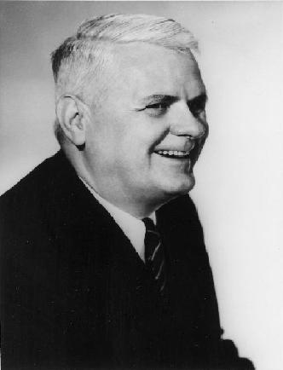
History
ISWIM
λ
1958
1966
LISP
ML
1930-ish
1962
APL
1973
F#
FP
2005
Clojure
1977
2007
2003
Scala
Erlang
1986
Ocaml
Haskell
1996
1988

Slide 5
Functional Programming Influence
Continue Evolution of GC – Lisp ~1958
Generics – ML ~ 1973
In early 1994, support for lambda, filter, map, and reduce was added to Python
First-class functions were also introduce Visual Basic 9, C# and C++ 11
Java 8 supports lambda expressions as a replacement for anonymous classes
Is Lazy Evaluation is part of the main stream languages such as C#
Type Inference, example is the “var” keyword in C#
Programming in a functional style can also be accomplished in languages that aren't specifically designed for functional programming, Lots of modern languages have elements from FP
Perl has been the subject of a book describing how to apply functional programming concepts
C# 3.0 & Java 8 added constructs to facilitate the functional style (lambda, generics, linq)

Slide 6
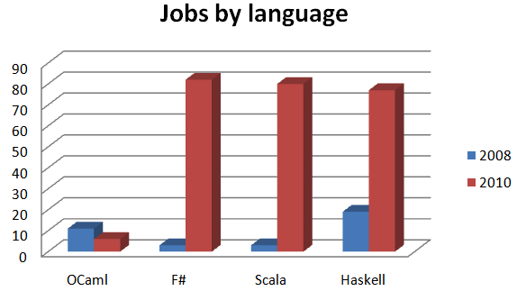
Functional Job Trend
Functional languages are sprouting not just on the JVM where the two most interesting new languages are Scala and Clojure, but also on the .NET platform, where F# is a first-class citizen
http://www.itjobswatch.co.uk

Slide 7
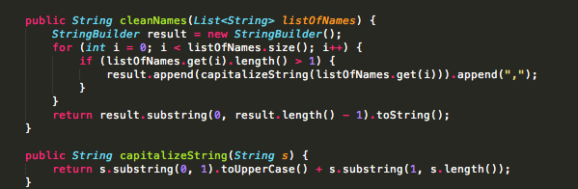
Imperative vs Functional programming
Given a list of names, some of which consist of a single character, you are asked to return a comma-delimited string with the single letter names removed, with each name capitalized.

Slide 8
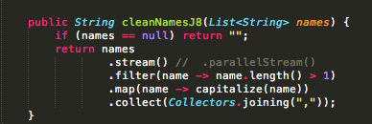
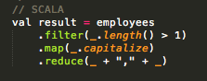
Imperative programming vs Functional
Given a list of names, some of which consist of a single character, you are asked to return a comma-delimited string with the single letter names removed, with each name capitalized.

Slide 9
Imperative vs Functional programming
To solve problems, OOP developers design class hierarchies, focus on proper encapsulation. | Functional programming approaches computational problems as an exercise in the evaluation of pure functional transformations of data collections.
OOP describes a style of programming modeled as a sequence of commands, that modify state, which are used to implement I/O. | FP describes programs as expressions and transformations, and tries to avoid mutable state and side effects, and emphasizes the application of functions
In OOP we write the code that describes in details steps to accomplish the goal (How) | FP is declarative, write code in FP involves composing the problem as a set of functions to be executed (What)

Slide 10
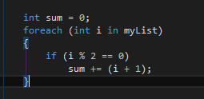
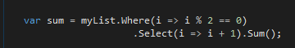
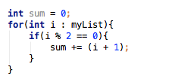
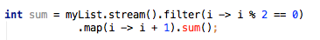
Little ceremony C# - Java

Slide 11
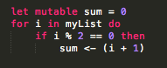
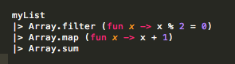
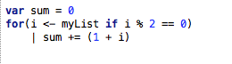
Little ceremony F# - Scala

Slide 12
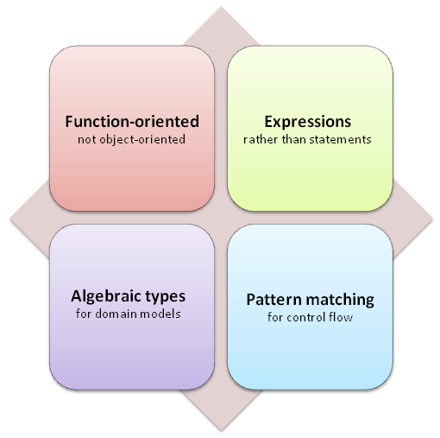
Four Key Concepts
FP is different in many ways from a standard
imperative language, but there are a few
major differences that are particularly
important to understand:
Function-oriented rather than OO
Expressions rather than statements
Algebraic types for creating domain models
Pattern matching for flow of control

Slide 13

FP vs OOP the Switch ?@#?%!
Functional Programming may look scary for an object-oriented developer because of all the strange buzzwords like Functor, Referential Transparency, Monads, etc., but they are really just unfamiliar terms.
Object-oriented programming can be a scary one with all its concepts, e.g. polymorphism, encapsulation,
inheritance, covariance, etc.

Slide 14
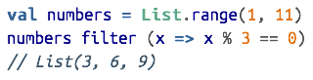
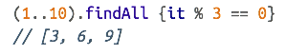
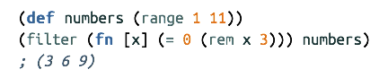
Synonym Suffering
Functional programming languages feature several families of common functions. Yet developers sometimes have a hard time moving between languages because familiar functions have unfamiliar names. Functional languages tend to name these common functions based on functional paradigms.
Filter in Scala Filter in Groovy
Filter in Clojure

Slide 15
Case: Number Classification
A perfect number equals the sum of its positive divisors, the pairs of numbers whose product yields the target number, excluding the number itself.
Perfect number sum of factors = number
Abundant number sum of factors > number
deficient number sum of factors < number

Slide 16

Hello Functional Programming
Notes:
Code Sample?
NumberTraslator

Slide 17
What is "Functional Programming?"
Functional programming is so called because a program consists entirely of functions.
Declarative
λ
First class
Higher-Order
Functions
Immutability
… is all about functions! Identifying an abstraction and building a function, use existing functions to build more complex abstractions, pass existing functions to other functions to build even more complex abstractions

Slide 18
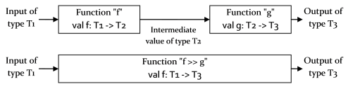
Function-oriented rather than OO
Function Composition - Building with composition. Composition is the 'glue' that allows us build larger systems from smaller ones. This is the very heart of the functional style. Almost every line of code is a composable expression. Composition is used to build basic functions, and then functions that use those functions, and so on.
Composition — in the form of passed parameters plus first-class functions

Slide 19
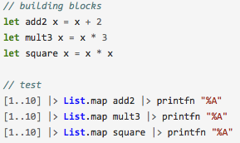
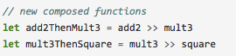
Using functions as building blocks
A well-known principle of good design is to create a set of basic operations and then combine these building blocks in various ways to build up more complex behaviors

Slide 20
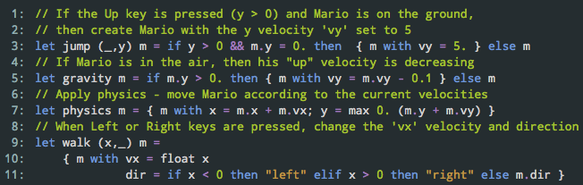
Compose Mario
Mario game sample, based on functional reactive Elm script (http://elm-lang.org/edit/examples/Intermediate/Mario.elm)
The functions that depend on keyboard take the current keyboard state as the first argument. This is represented as a tuple int*int (dir) consisting of x and y directions.
The step function of the game takes previous Mario value and returns a new one. It is composed from 4 functions that represent different aspects of the game.

Slide 21
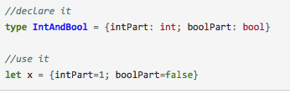
Algebraic Types
The type system in FP is based on the concept of algebraic types. The new compound types are built by combining existing types in two different ways:
A combination of values, each picked from a set of types.
As a disjoint union representing a choice between a set of types.

Slide 22
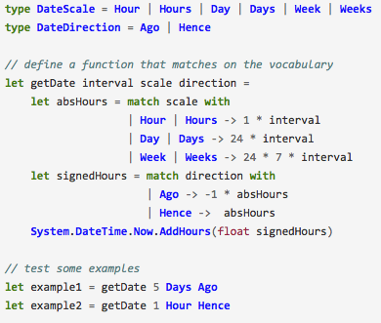
Algebraic Types for DSL
Domain-specific languages are well recognized as a technique to create more readable and concise code.
The functional approach is very well suited for DSL.
The ability to create new types concisely and then match against them makes it very easy to set up fluent interfaces quickly.

Slide 23
Algebraic Types for DDD
The conciseness of the type system in FP is particularly useful when doing domain driven design (DDD)
“Value” objects in DDD should have structural equality, meaning that two objects containing the same data should always be equal. In FP you get this for free by default.

Slide 24
Functional characteristics
Higher Order Function & Pure Function
Referential Transparency
Curry & Partial Application
Immutability & Side Effects
Memoization & Lazy Evaluation
Recursion & Pattern Macthing

Slide 25
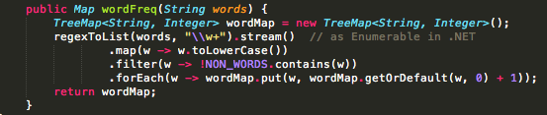
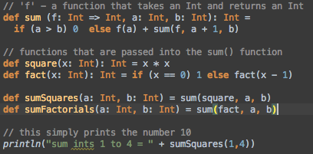
Higher-Order functions
A higher-order function is a function that takes another function as a parameter, or a function that returns another function as a value, or a function which does both.
"program to an interface, not an implementation“… in Functional Programming all functions are “interfaces”, meaning that many of the roles that interfaces play in object-oriented design are implicit in the way that functions work.

Slide 26
Properties and Benefits of Pure Functions
A function always gives the same output value for a given input value, I can then cache the result
A function has no side effects, If the result of a pure expression is not used, it can be removed without affecting other expressions
If there is no data dependency between two pure expressions, then their order can be reversed or performed in parallel
The function does not rely on any external state, Increased readability and maintainability.
Pure functions can more easily isolated, easier testing and debugging.

Slide 27

Immutability
Immutability is very important characteristic of FP but mostly is about transformation of state… concept of function purity
Immutable data forces you to use a “transformational” approach
When you’re writing programs using immutable types, the only “thing a method can do is return a result, it can’t modify the state of any objects
Immutable data makes the code predictable is easier to work
Prevent Bugs
Concurrency is much simpler, as you don’t have to worry about using locks to avoid update conflicts
Automatic thread-safe

Slide 28
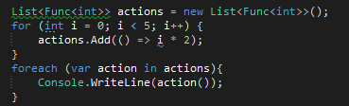
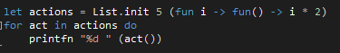
Immutability
Mutable values cannot be captured by closures!

Slide 29
Mutability – The PAIN
Screwupability
Use of mutable states

Slide 30

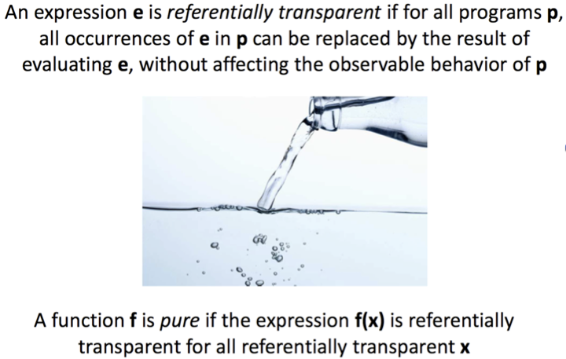
Referential Transparency
WTFooof

Slide 31
Referential Transparency
A function is said to be referential transparency if it can be replaced with is value without changing the behavior of a program.
The importance of referential transparency are:
It can help in proving correctness
It simplifies an algorithm
lazy evaluation
can be memoized (transformed into equivalent functions which cache results)
Parallelization, I can change the order of execution without jeopardize the behavior

Slide 32
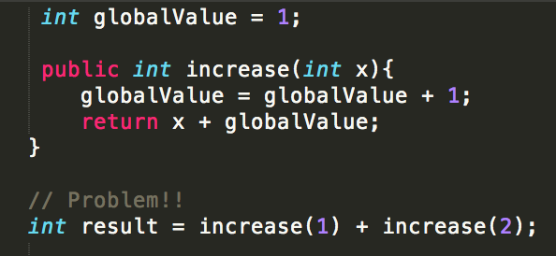
Referential Transparency
A function is said to be referential transparency if it can be replaced with is value without changing the behavior of a program.
Increase method without Referential Transparency

Slide 33
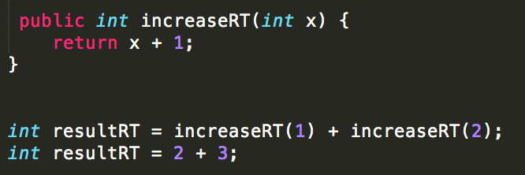
Referential Transparency
A function is said to be referential transparency if it can be replaced with is value without changing the behavior of a program.
Increase method with Referential Transparency

Slide 34
Side Effects
Side effects aren’t bad…

Slide 35

Unwanted Side Effects are Evil!
Side effects aren’t bad…
unwanted side effects are EVIL
and the root of many bugs!
One of the biggest advantages with functional programming is that the order of execution of “side effect free functions” is not important.
… “side effect free functions” are easy to parallelize

Slide 36
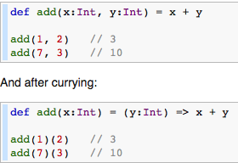
Currying
Curry is a technique in which a function is applied to its arguments one at a time, with each application returning a new function that accepts the next argument
Higher-order function enable
Partial Application and Currying

Slide 37
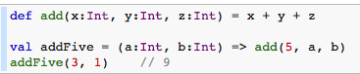
Partial Application
Partial Application refers to the process of fixing a number of arguments to a function, producing another function of smaller arity
With both currying and partial application, you supply argument values and return a function that’s invokable with the missing arguments. But currying a function returns the next function in the chain, whereas partial application binds argument values to values that you supply during the operation, producing a function with a smaller arity

Slide 38
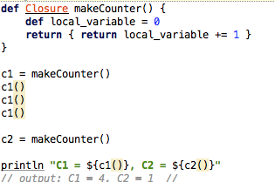
Closure
Closures are much like lambda’s except they reference variables outside the scope of the function
Closures carries an implicit binding to all the variables referenced within it.
In other words, the function (or method) encloses a context around the things it references.
Closures is great to implement a “deferred execution”
By binding code to a closure block, you can wait until later to execute the block when needed.

Slide 39
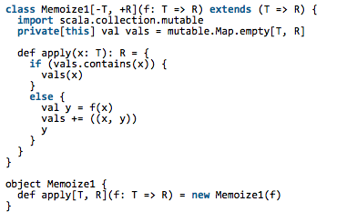
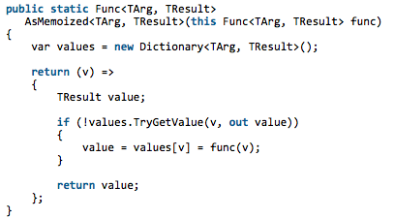
Memoization
Memoization enables automatic caching of recurring function-return values.

Slide 40
Lazy Evaluation - Strict & Non-Strict Evaluation
Lazy evaluation deferral of expression evaluation for as long as possible until absolutely needed
Languages can be categorized as strict (eagerly evaluating all expressions) or lazy (deferring evaluation)
Strict evaluation always fully evaluates function arguments before invoking the function
Lazy evaluation does not evaluate function arguments unless their values are required to evaluate the function call itself
Lazy evaluation allows the creation of infinite sequences: lists that have no upper bound

Slide 41
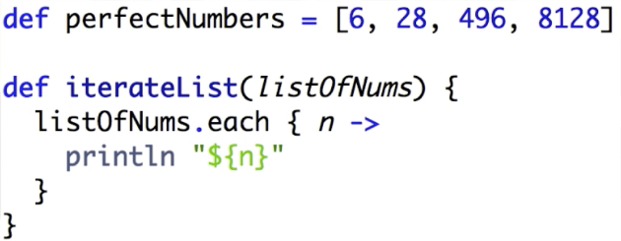
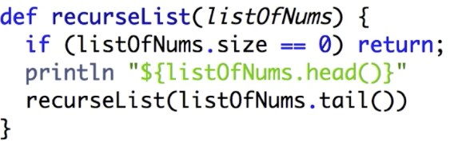
Recursion
In functional programming “iteration” is ~usually~ accomplished via recursion.
Recursive function invoke themselves
Tail recursion is optimized by compiler avoiding to maintain a stack ~stack over flow!

Slide 42
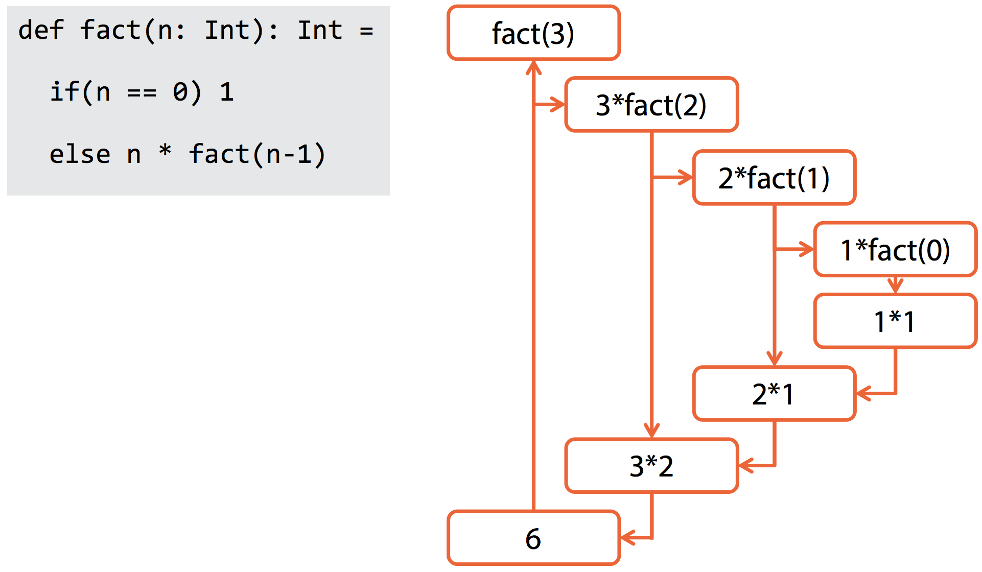
Recursion

Slide 43
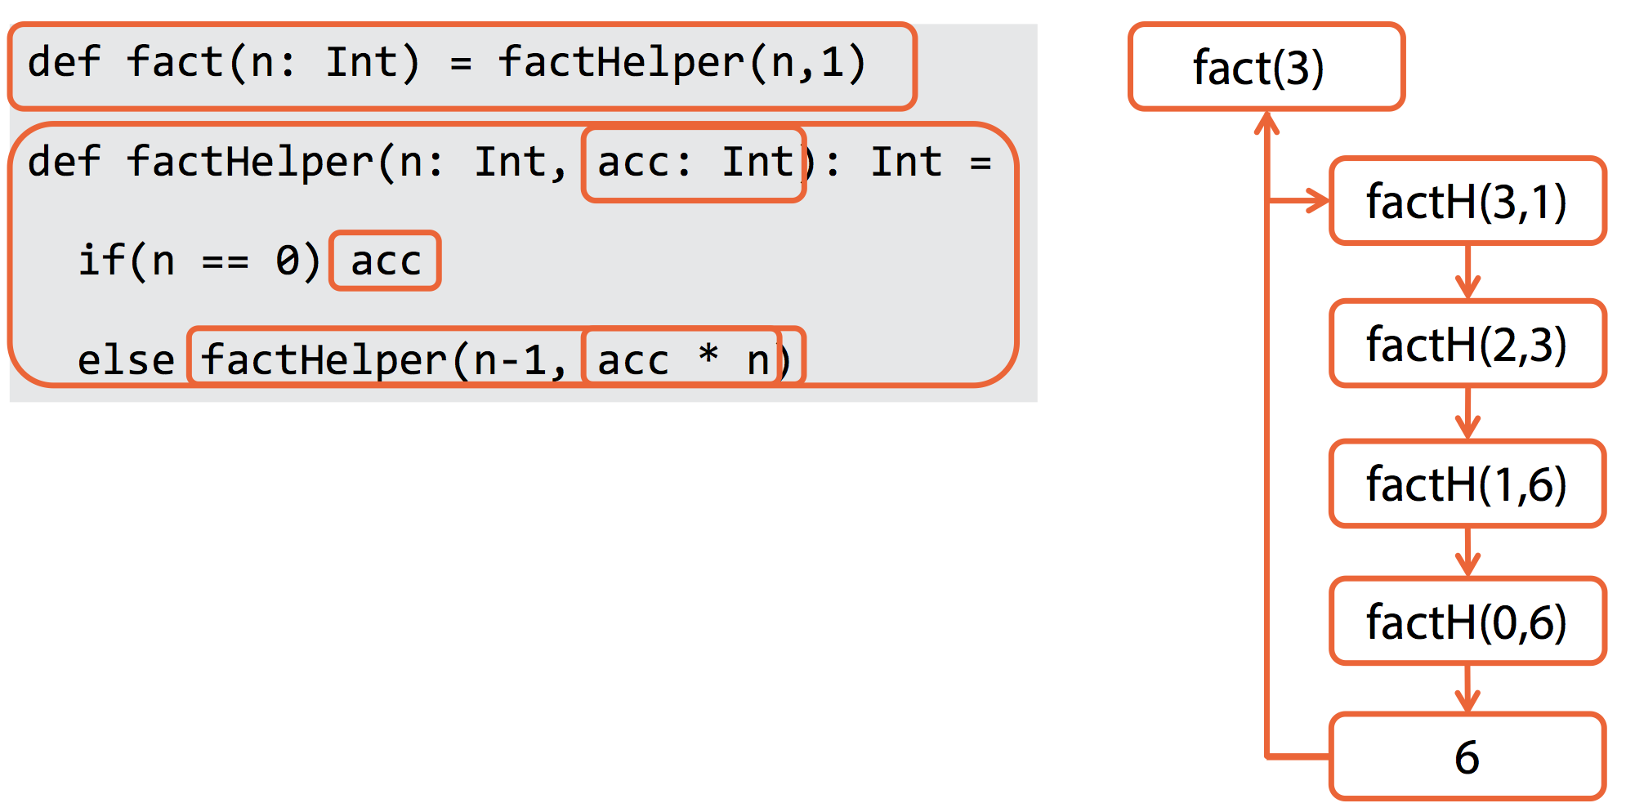
Tail Recursion

Slide 44
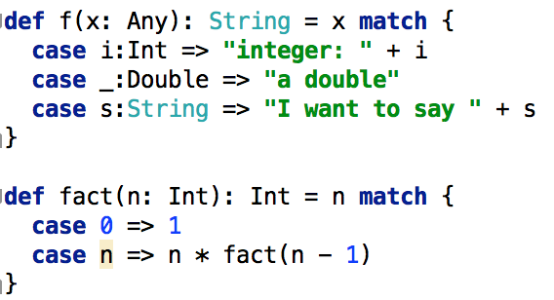
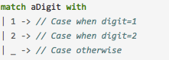
Pattern matching for flow of control
In FP there is one conditional expression, which is based on pattern-matching.
Pattern matching is used instead of inheritance to work with different variants of an underlying type. Pattern matching works seamlessly with these types to create a flow of control for each choice.

Slide 45
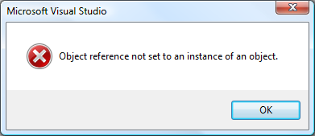
The Curse of null

Slide 46

The Curse of null
I call it my billion-dollar mistake
Who did say it?

Slide 47
The Curse of null
I call it my billion-dollar mistake
Who did say it?
Tony Hoare

Slide 48
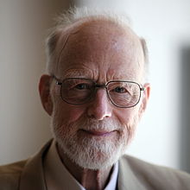
Tony Hoare
I call it my billion-dollar mistake.
It was the invention of the null reference in 1965. At that time, I was designing the first comprehensive type system for references in an object oriented language (ALGOL W). My goal was to ensure that all use of references should be absolutely safe, with checking performed automatically by the compiler. But I couldn't resist the temptation to put in a null reference, simply because it was so easy to implement.
This has led to innumerable errors, vulnerabilities, and system crashes, which have probably caused a billion dollars of pain and damage in the last forty years.

Slide 49
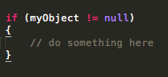
The billion dollar mistake!
Is this a common scenario?
The caller should always check for an invalid case, namely testing for nulls.
Unfortunately, this test is not required by the compiler. All it takes is for one piece of code to forget to do this, and the program can crash.

Slide 50
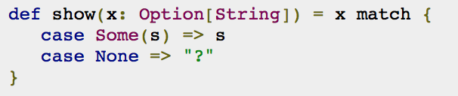
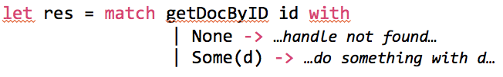
The Possible $olution!
In pure FP, nulls cannot exist accidentally. A string or object must always be assigned to something at creation, and is immutable thereafter.

Slide 51

Why Functional Programming?

Slide 52
Why Functional Programming?
Simple Code for Complex Problems
Declarative programming style
Functional Programming promotes Composition and Modularity
Concurrency, FP is easy to parallelize - Locking vs. immutable memory
Convenience
Correctness & Reduced bugs
Conciseness
Rapid Prototyping

Slide 53
Complex Simple
static Tree<KeyValuePair<A, bool>> DiffTree<A>(Tree<A> tree, Tree<A> tree2)
{
return XFoldTree(
(A x, Func<Tree<A>, Tree<KeyValuePair<A, bool>>> l, Func<Tree<A>, Tree<KeyValuePair<A, bool>>> r,
Tree<A> t)
=> (Tree<A> t2) => Node(new KeyValuePair<A, bool>(t2.Data, ReferenceEquals(t, t2)), l(t2.Left), r(t2.Right)),
x1 => y => null, tree)(tree2);
}

Slide 54
Complex Simple
static Tree<KeyValuePair<A, bool>> DiffTree<A>(Tree<A> tree, Tree<A> tree2)
{
return XFoldTree(
(A x, Func<Tree<A>, Tree<KeyValuePair<A, bool>>> l, Func<Tree<A>, Tree<KeyValuePair<A, bool>>> r,
Tree<A> t)
=> (Tree<A> t2) => Node(new KeyValuePair<A, bool>(t2.Data, ReferenceEquals(t, t2)), l(t2.Left), r(t2.Right)),
x1 => y => null, tree)(tree2);
}

Slide 55
Complex Simple
static Tree<KeyValuePair<A, bool>> DiffTree<A>(Tree<A> tree, Tree<A> tree2)
{
return XFoldTree(
(A x, Func<Tree<A>, Tree<KeyValuePair<A, bool>>> l, Func<Tree<A>, Tree<KeyValuePair<A, bool>>> r,
Tree<A> t)
=> (Tree<A> t2) => Node(new KeyValuePair<A, bool>(t2.Data, ReferenceEquals(t, t2)), l(t2.Left), r(t2.Right)),
x1 => y => null, tree)(tree2);
}

Slide 56
Complex Simple
static Tree<KeyValuePair<A, bool>> DiffTree<A>(Tree<A> tree, Tree<A> tree2)
{
return XFoldTree(
(A x, Func<Tree<A>, Tree<KeyValuePair<A, bool>>> l, Func<Tree<A>, Tree<KeyValuePair<A, bool>>> r,
Tree<A> t, t2)
=> (Tree<A> t2) => Node(new KeyValuePair<A, bool>(t2.Data, ReferenceEquals(t, t2)), l(t2.Left), r(t2.Right)),
x1 => y => null, tree)(tree2);
}

Slide 57
Complex Simple
static Tree<KeyValuePair<A, bool>> DiffTree<A>(Tree<A> tree, Tree<A> tree2)
{
return XFoldTree(
(A x, Func<Tree<A>, Tree<KeyValuePair<A, bool>>> l, Func<Tree<A>, Tree<KeyValuePair<A, bool>>> r,
Tree<A> t, t2)
=>
let (Node(x2, l2, r2)) = t2
Node((x2, t=t2), l l2, r r2)) (fun _ _ -> Leaf) tree tree2;
}

Slide 58
Complex Simple
static Tree<KeyValuePair<A, bool>> DiffTree<A>(Tree<A> tree, Tree<A> tree2)
{
return XFoldTree(
(A x, Func<Tree<A>, Tree<KeyValuePair<A, bool>>> l, Func<Tree<A>, Tree<KeyValuePair<A, bool>>> r,
Tree<A> t, t2)
=>
let (Node(x2, l2, r2)) = t2
Node((x2, t=t2), l l2, r r2)) (fun _ _ -> Leaf) tree tree2
}

Slide 59
Complex Simple
static Tree<KeyValuePair<A, boolet DiffTree<A>(Tree<A> tree, Tree<A> tree2)
{
return XFoldTree(fun
(A x, Func<Tree<A>, Tree<KeyValuePair<A, bool>>> l, Func<Tree<A>, Tree<KeyValuePair<A, bool>>> r,
Tree<A> t, t2)
->
let (Node(x2, l2, r2)) = t2
Node((x2, t=t2), l l2, r r2)) (fun _ _ -> Leaf) tree tree2
}

Slide 60
Complex Simple
let DiffTree( tree, tree2) =
XFoldTree(fun x, l, r, t, t2)->
let (Node(x2,l2,r2)) = t2
Node((x2,t=t2), l l2, r r2)) (fun _ _ -> Leaf) tree tree2

Slide 61
Complex Simple
static Tree<KeyValuePair<A, bool>> DiffTree<A>(Tree<A> tree, Tree<A> tree2)
{
return XFoldTree(
(A x, Func<Tree<A>, Tree<KeyValuePair<A, bool>>> l, Func<Tree<A>, Tree<KeyValuePair<A, bool>>> r,
Tree<A> t)
=> (Tree<A> t2) => Node(new KeyValuePair<A, bool>(t2.Data, ReferenceEquals(t, t2)), l(t2.Left), r(t2.Right)),
x1 => y => null, tree)(tree2);
}

Slide 62
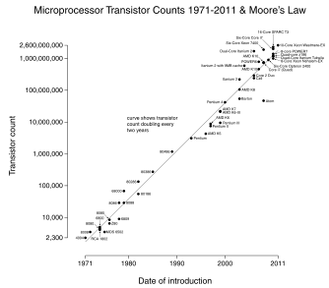
Concurrency
Modern computers come with multiple processors, each equipped with multiple cores, but the single processor is slower than used to be!
Moore’s law (http://en.wikipedia.org/wiki/Moore's_law)
… to achieve great performances the application must be leveraging a Concurrent Model

Slide 63
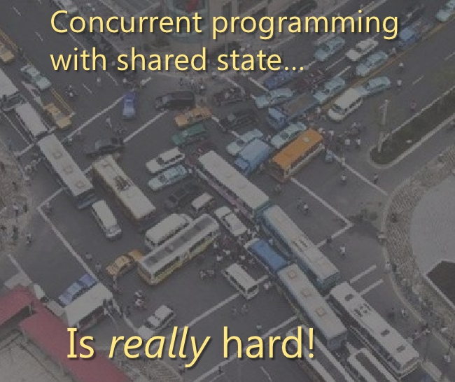
Concurrency… jams to avoid!
Parallel, asynchronous, concurrent, and reactive programs bring many challenges because these programs are nearly always nondeterministic
This makes debugging/testing challenging
Deadlocking & Livelocking
Not easy to program
Concurrency is a double-edged sword

Slide 64
Concurrency
Imperative programming gives us three bad headaches:
It’s difficult to turn existing sequential code into parallel code
Using shared state and locks is difficult
If two or more different threads can change the same data at the same time
Functional programming gives us the answers:
Thanks to the immutability and Lazy Evaluation, we avoid introducing race conditions and we can write lock-free code.
When using a declarative programming style we can introduce parallelism into existing code. We can replace a few primitives that specify how to combine commands with a version that executes commands in parallel
Actor Model (Erlang, Scala, F#, Clojure… C# DataFlow??)

Slide 65
Actor Model
The (Actor Model)’s implementation of Erlang-style message passing
An actor is an independent computational entity which contains a queue, and receives and processes messages

Slide 66
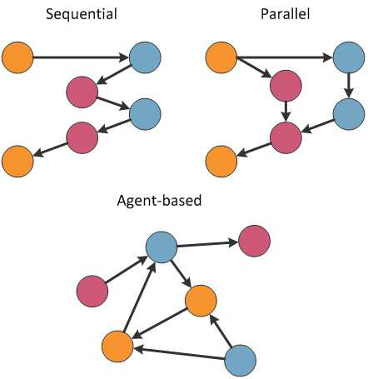
Actor Model
What does a system of actors look like?

Slide 67
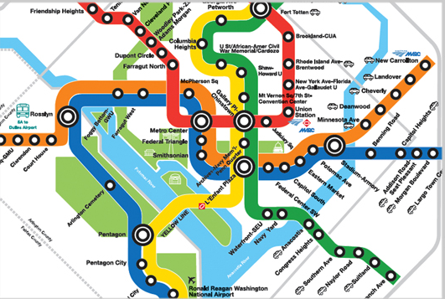
Actor Model
What does a system of actors look like?

Slide 68
What Actor Model can do?
Maintain private state
Accessed safely, can mutable or immutable
React to messages differently in different states
Actors perform actions
Do calculations and update state
Notify other actors
Expose events that others can listen to
Send reply to the sender of a message

Slide 69
Pipeline Processing
Values processed in multiple steps
Worker takes value, processes it, and sends it
Worker is blocked when source is empty
Worker is blocked when target is full
Steps of the pipeline run in parallel

Slide 70

Why should I care?
Legacy code not functional
Bad interop, few libs
Devs find it too hard
Customers don’t care anyway

Slide 71
When Functional Programming?
NOW!

Slide 72
Real World Uses
F# Svea Ekonomi, Microsoft (Halo-Game), Credit Suisse, Prover
Haskell AT & T, Scrive
Erlang Ericsson, Amazon (SimpleDB), Facebook
Lisp Yahoo Store
Scala Twitter, LinkedIn

Slide 73
Wrap-Up
Functional Programming is a machine for transforming data
Immutability and lazy evaluation are your best friends for composition! (remember Mario)
Confine side-effects, don’t fight them!
Cede control to the compiler with higher-order functions
Functional programming is inherently recursive and highly parallelizable
Concurrency and reliability are becoming more and more required, FP will help you!
Be pragmatic and use the right tool for the job
Poly-paradigm programming is more powerful and effective than polyglot programming

Slide 74
Q & A ?
The tools we use have a profound (and devious!) influence on our thinking habits, and, therefore, on our thinking abilities.
-- Edsger Dijkstra

Slide 75
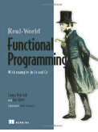


References
Why Functional Programming Matters (John Hughes) http://www.cs.kent.ac.uk/people/staff/dat/miranda/whyfp90.pdf
http://rosettacode.org

Slide 76

How to reach me
github.com/DCFsharp meetup.com/DC-fsharp/ @DCFsharp rterrell@microsoft.com

Slide 77
Scala
Runs on the JVM, so It can run side by side with existing deployments
Can use Java library directly, so developers can leverage existing frameworks
It is statically type as Java
The syntax is relatively close to Java’s
It supports both OOP and FP paradigms
programmers can gradually learn to apply FP ideas in their code
programmers are free to choose which programming style apply
Most of Scala’s strengths are centered around an advanced programming paradigm that integrates well with the Java environment and some core well-designed features. In particular, actors, pattern matching.

Slide 78
Erlang
Built for Concurrency
Erlang is a product of years of research from Ericsson to develop near- real-time fault-tolerant distributed applications for telecom applications.
Erlang can support insanely reliable systems.
You can’t take a phone switch down for maintenance, and you don’t have to take Erlang down to replace entire modules
Actor Model
Distributed message passing is a basic language-level construct, eliminating the need for locking and improving concurrency.
Reliability
Erlang does have traditional error checking, but in a traditional application. The Erlang mantra is “Let it crash.” Since Erlang makes it easy to monitor the death of a process, killing related processes and starting new ones are trivial exercises.
Core Strengths
Erlang is all about concurrency and fault tolerance, from the inside out. As processor designers look to distributed cores, the state of the art in programming must evolve. Erlang’s strengths are in the most important areas that this generation of programmers will face.

Slide 79
Clojure
Clojure is Lisp on the JVM …is yet another Lisp dialect.
Understanding Clojure starts with understanding Lisp.
It’s a functional language but not a pure functional language.
For Clojure, one of the most important characteristics is the JVM.
you can access the tens of thousands of Java libraries to do just about anything you need.
Clojure and Java desperately need each other. Lisp needs the market place that the Java virtual machine can offer, and the Java community needs a serious update and an injection of fun.
Clojure is a functional language, with emphasis on functions without side effects. But when you do use mutable state, the language sup- ports a number of concepts to help. Transactional memory works like transactional databases to provide safe, concurrent access to mem ory. Agents allow encapsulated access to mutable resources.
Concurrency
Clojure’s approach to concurrency has the potential to change the way we design concurrent systems completely. STM does place some addi- tional burden on developers because of its novelty, but for the first time, it protects developers by detecting whether state mutations happen within appropriately protected functions. If you’re not within a trans- action, you can’t mutate state.

Slide 80
Haskell (1990)
Haskell represents purity and freedom for many functional programming purists. It’s rich and powerful, but the power comes at a price. You can’t eat just a couple of bites. Haskell will force you to eat the whole functional programming burrito.
Where Scala, Erlang, and Clojure let you use imperative concepts in small doses, Haskell leaves no such wiggle room. This pure functional language will challenge you when it’s time to do I/O or accumulate state.
Haskell was built from the ground up to be a pure functional language, combining ideas from the best functional languages, with special emphasis on lazy processing.
As a pure functional language, Haskell does not do side effects. Instead, a function can return a side effect, which is later executed.
Purity of Programming Model
Pure programming models can radically change the way you approach problems. They force you to leave old programming paradigms behind and embrace different ways of doing things. Pure functional languages give you something you can depend on.
Expressiveness
The Haskell language has fantastic power. From an abstract sense, it has everything you need to express powerful ideas concisely. Those ideas encompass behavior through a rich functional library and a pow- erful syntax.
Academic

Slide 81
F# (2005)
Strongly typed, multi-paradigm programming language,
Cross platform CLI language, can be used to generate Javascript and GPU code
Is Open Source
F# is a functional programming language for the .NET Framework. It combines the succinct, expressive, and compositional style of functional programming with the runtime, libraries, interoperability, and object model of .NET.
F# is first-class .NET citizen. Not only can it access any of the standard .NET components but any other .NET language can access code developed in F#. This makes it possible to use F# to develop standalone .NET applications as well as parts of larger projects.
F# is a strongly-typed, functional-first, open-source, cross-platform programming language for writing simple code to solve complex problems. From the business perspective, the primary role of F# is to reduce the time-to-deployment for analytical software components in the modern enterprise. Its interoperability with other languages and libraries and its ability to tackle the complexity of components such as calculation engines and data-rich analytical services offer a compelling story for businesses.

